Slide 1
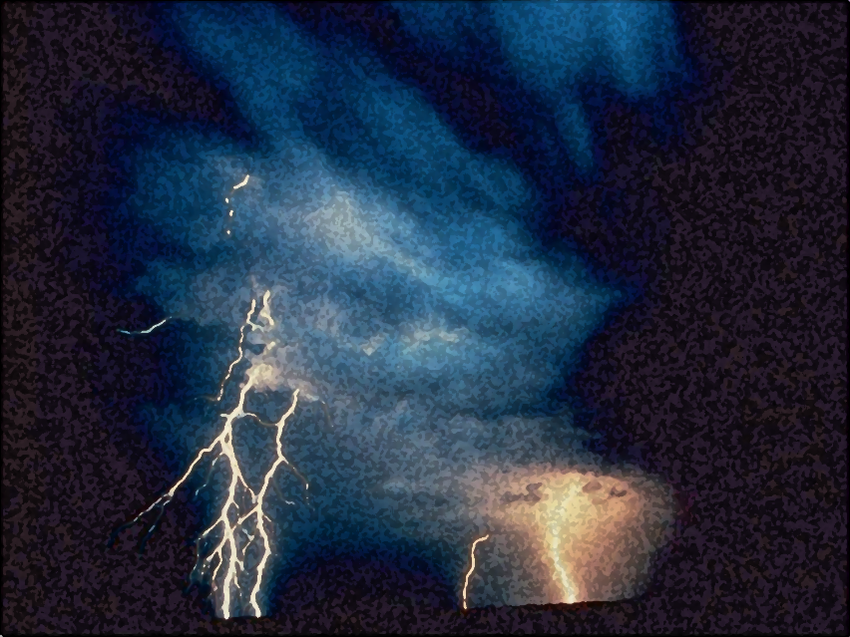
A Light out of Darkness
The Vision of Isaiah
Doom to Bloom

Slide 2
The Vision of Isaiah
A Call to Servanthood
How to become a useful, faithful and righteous servant of God?

Slide 3
The Vision of Isaiah
In Whom Shall We Trust,
the Nations or the LORD?
Example of Distrust
7-12
Ahaz
God: Master of the Nations
13-35
Example of Trust
36-39
Hezekiah
Notes:
Chapter 7-12 gives us an historical example of distrust in the LORD. King Ahaz is given an opportunity to trust in the Lord but refuses to listen, a fulfillment of 6:9-10. The LORD offers him a sign, evidence that the LORD can be trusted. But He refuses to accept the sign. He refuses to trust in the LORD and His word. He instead decides to trust in Assyria and their many gods. Ahaz seeks the help of Tiglath-Pileser king of Assyria, but receives no help, but more trouble. He gets rid of one problem and gets a bigger one in return. The LORD now makes an appearance, prophesied in the sign of Immanuel, “God with us” promised judgment and destruction is upon them when the LORD appears in the form of an invading army. Total destruction is averted at that time, but God will be back.
On the other end we have another historical example, one of trusted in the LORD. King Hezekiah is faced with the same problem, an invading army, the Assyrian have invaded and surrounded him and the nation, with no hope of escape or deliverance. Hezekiah seeks the LORD for help and trusts in the Him and is saved, from destruction and death. The invading army is miraculously destroyed by the LORD Himself. Ahaz trusts Assyria and Israel is destroyed. Hezekiah trusts the LORD and Assyria is destroyed.
Between the two segments is a section whose theme is the God of Israel is the Lord of the nations.

Slide 4
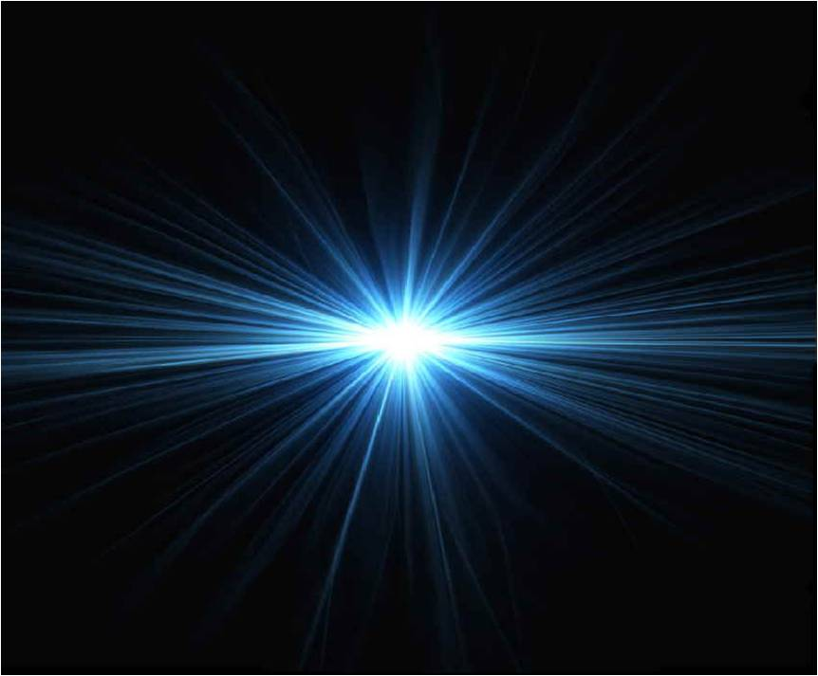
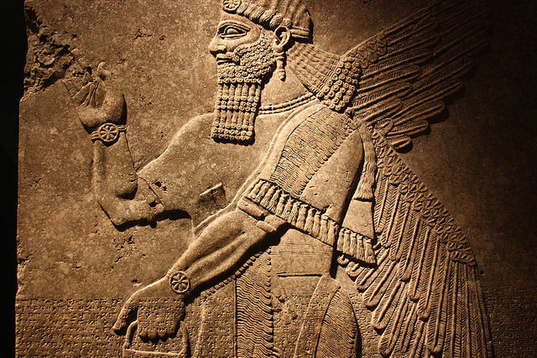
The Vision of Isaiah
God or Assyria?
An Example of Distrust
7-12
Notes:
In whom will Ahaz trust? The LORD of the universe of the lord of Assyria. In whom will man trust? God or Man. Will you choose light or darkness?

Slide 5
Will You Believe?
God is with Us
7:10 – 8:10
“Believe It or Not”

Slide 6
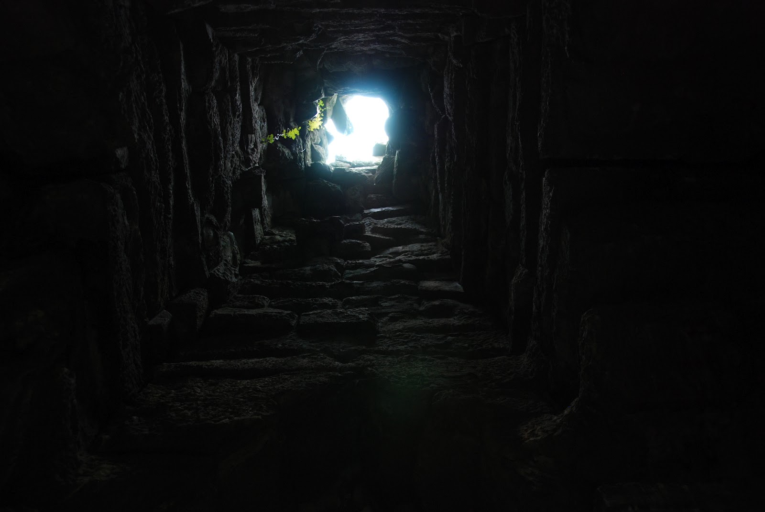
Will You Believe?
Our Way – Darkness;
His Way – Light
8:11-23

Slide 7
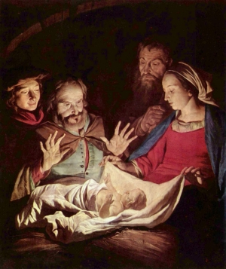
Will You Believe?
Unto Us a Child is Born
9:2-7
Notes:
Isaiah reaches the climax that began in 7:1. In place of a unfaithful king, who refuse to trust in the LORD, there is lifted up the idea king who, though a child, will bring an end to all wars and conflicts, and establish an eternal kingdom based upon justice and righteousness. The names no longer express future events or situations, nor express the relationship between God and His people. Rather, they express the remarkable nature of the individual and the saving character of his reign. He is the ultimate expression that God is with us “Immanuel”, not for our destruction, but for our redemption. (Oswalt, p. 241) He is the one with whom we shall trust! The theme of the entire division.
God’s ultimate purpose found in 9:1-7 concludes the reflection which began in 8:11. Dependence upon our own resources and perspectives for guidance only leads into darkness. Ahaz lead the nation into darkness by refusing the instruction and testimony of God, But out of the helplessness of that darkness God would, through the coming child king, shine a light of his own delivering power. This deliverance is a cause for rejoicing (9:1-2), the result of God’s activity in freeing them and an end to war, the result of which is the birth of the idea King and the description of the King’s reign.

Slide 8
Unto Us a Child is Born
“Nevertheless the gloom will not be upon her who is distressed, as when at first He lightly esteemed the land of Zebulun and the land of Naphtali, and afterward more heavily oppressed her, by the way of the sea, beyond the Jordan, in Galilee of the Gentiles.” (9:1)
Notes:
The previous section ended in gloom and doom. But out of darkness and gloom comes a great light. The doom will turn to a bloom when the LORD first appears from the land of Galilee, the land between the seas, where a people walking in darkness shall see a great light.

Slide 9
Unto Us a Child is Born
“The people who walked in darkness have seen a great light; Those who dwelt in the land of the shadow of death, upon them a light has shined.” (9:2)
Notes:
With the suddenness of dawn come the announcement that light has appeared to these people; “Then suddenly there were a host of angles…”
Throughout the Bible, God presence is equated with light and even the depths of their sin and rebellion is not able to keep God from manifesting Himself to them, to us. If they wished to be free of their sin, nothing could prevent God’s light from shining as it has in Jesus.
All the verbs are in the perfect tense, these are prophetic perfects describing a future event with the certainty of a completed action.

Slide 10
Unto Us a Child is Born
“You have multiplied the nation and increased its joy; They rejoice before You according to the joy of harvest, as men rejoice when they divide the spoil.” (9:3)
Notes:
As a result of God’s revelation of Himself through the coming saving King, joy sweeps over the people, the joy of great abundance. Instead of a dwindling population and a very small remnant, the nation swells and grows; instead of meagerness of harvests there is abundance; instead of becoming spoil themselves, they divided the spoil among themselves. All the elemental fears of people is turned to joy and relief. The real source of joy is the LORD, It is in Him they rejoice.

Slide 11
Unto Us a Child is Born
“For You have broken the yoke of his burden and the staff of his shoulder, the rod of his oppressor, as in the day of Midian.” (9:4)
Notes:
They rejoice, “will rejoice” because the LORD has delivered them, has freed them. It is apparent from the whole context that it is the final deliverance which is in view.
The yoke of oppression which is broken or better replaced is both spiritual and physical. God breaks the sinful bondage of mankind, if he walks and lives in the Spirit, made possible by Christ’s death and resurrection. God also breaks the bondage of political and social oppression. Christ breaks the yoke of sin in order to lift the yoke of oppression. Peace with God makes peace among men possible.
The Assyrians bragged about the heavy yokes upon the people with whom they had taken captive. Isaiah looks to the day when One mightier than the Assyrians of this world will break the yokes to pieces. He will also impose a yoke, but His yoke is easy (Matt. 11:29-30)
“in the day of Midian” – Is this eternal ending of all wars and oppression just a pipe dream, or only to be fulfilled in a spiritual sense? Isaiah makes a historical connection with the past to give credence to the future. Gideon and his people faced an unsurmountable horde of Midianites out to ravage the land, but they learned that in God weakness is strength. They watched in amazement God bring deliverance. Isaiah eludes to a past event as evidence that the future deliverance is entirely feasible, given the character and power of their God. (Oswalt, p. 244)

Slide 12
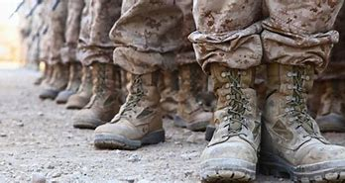
Unto Us a Child is Born
“For every warrior's sandal from the noisy battle, and garments rolled in blood, will be used for burning and fuel of fire.” (9:5)
Notes:
How will the LORD bring and end to the yoke of oppression? By putting an end to the warfare upon which oppression rests. “God will not replace oppression with greater oppression, nor will replace war with warfare. Instead, he will do away with wars altogether. (Isaiah 2:4; Psalm 46:8-9)

Slide 13
Unto Us a Child is Born
“They shall beat their swords into plowshares, and their spears into pruning hooks; Nation shall not lift up sword against nation, neither shall they learn war anymore.” (2:4)

Slide 14
Unto Us a Child is Born
“Come, behold the works of the LORD, Who has made desolations in the earth. He makes wars cease to the end of the earth; He breaks the bow and cuts the spear in two; He burns the chariot in the fire.” (Psalm 46:8-9)

Slide 15
Unto Us a Child is Born
“For every warrior's sandal from the noisy battle, and garments rolled in blood, will be used for burning and fuel of fire.” (9:5)
Notes:
Isaiah uses a figure of the lesser to included the greater and in doing so insures the inclusion of the total. If boots and the clothes of war are burned, then the weapons of war will be disposed of and even more those who use them. Those who live by the sword will cease to be no more. The cloaks in whose fabric is mixed the blood of conqueror and conquered now feed the flames. Wars have ceased to be unto the ends of the earth.

Slide 16
Unto Us a Child is Born
“For unto us a Child is born, unto us a Son is given; And the government will be upon His shoulder. And His name will be called Wonderful, Counselor, Mighty God, Everlasting Father, Prince of Peace.” (9:6)

Slide 17
Unto Us a Child is Born
“For unto us a Child is born”
A Statement about His Humanity
He is the Son of Man
Notes:
He experienced every temptation common to humanity and to its fullest extent, but He never sinned. He experienced everything there is to experience as a human, even death

Slide 18
Unto Us a Child is Born
“Let this mind be in you which was also in Christ Jesus, who, being in the form of God, did not consider it robbery to be equal with God, but made Himself of no reputation, taking the form of a bondservant, and coming in the likeness of men....”

Slide 19
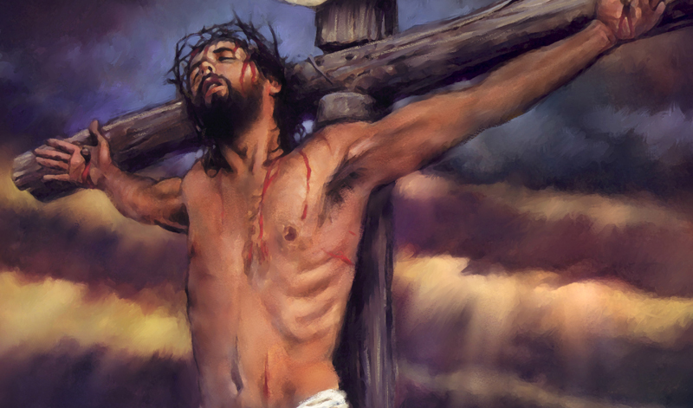
Unto Us a Child is Born
“And being found in appearance as a man, He humbled Himself and became obedient to the point of death, even the death of the cross.” (Phil. 2:5-8)

Slide 20
Unto Us a Child is Born
“unto us a Son is given;”
A Statement about His Deity
He is the Son of God
Notes:
The terminology speaks of the savior’s preexistent deity. He was given to us to be a Savior. Even though He did not look like God, He was still God. He was Immanuel - "God with us". It is a promise of incarnate deity, a prophecy that God Himself would appear as a human infant. We tend to focus of a baby in a manger, but the greater truth is that Baby’s identity, His deity!
He is “son of God” in relationship to the Father, not in essence or in His fundamental nature.

Slide 21
Unto Us a Child is Born
“And the government will be upon His shoulder. ”
A Statement about His Rule
He is the King of Kings
Notes:
Christ will reign over a literal earthly, geopolitical kingdom that encompasses all the kingdoms and governments of the world.

Slide 22
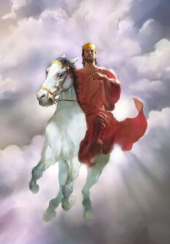
Unto Us a Child is Born
“And the LORD shall be King over all the earth. In that day it shall be – ‘The LORD is one,’ and His name one.” (Zech. 14:9)
Notes:
In that day, the responsibility of governing the whole world will rest on Him.

Slide 23
Unto Us a Child is Born
“And His name will be called…”
A Statement to Describe His Kingdom
He is the…

Slide 24
Unto Us a Child is Born
“And His name will be called…”
A Kingdom
without Confusion
“Wonderful Counselor”
Notes:
People said of Jesus that, "never did a man speak the way this man speaks". (John 7:46) He is the source of all truth -- I am the way, and the truth, and the life" (John. 14:6). He is the ultimate and only answer to all of life's confusion.

Slide 25
Unto Us a Child is Born
“And His name will be called…”
A Kingdom
without Chaos
“Mighty God”
Notes:
He is called God. The Mighty God is also the Almighty God "El shaddi" -- Jesus Christ,

Slide 26
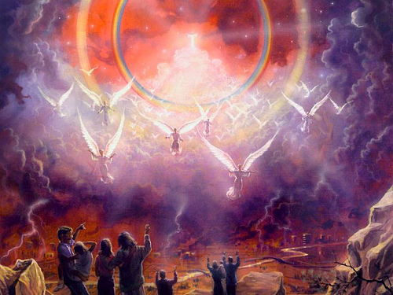
Unto Us a Child is Born
“Behold, He is coming with clouds, and every eye will see Him, even they who pierced Him. And all the tribes of the earth will mourn because of Him. Even so, Amen.”
Notes:
He not only tells His subjects what to do but He can energize them to do it. A human counselor has no ability to empower someone to do right. There will be no chaos about who is in control.

Slide 27
Unto Us a Child is Born
“I am the Alpha and the Omega, the Beginning and the End," says the Lord, "who is and who was and who is to come, the Almighty.” (Rev. 1:7-8)

Slide 28
Unto Us a Child is Born
“And His name will be called…”
A Kingdom
without Complexity
“Everlasting Father”
Notes:
This is not to confuse the fact that the Son is also the Father. The Messiah being the second person of the Trinity is in essence God. Therefore, He possesses all the attributes of God including eternality. Everlasting Father is an idiom used to describe the Messiah's relationship to time, not His relationship to the members of the Trinity. He is everlasting "EL Olam"

Slide 29
Unto Us a Child is Born
“But you, Bethlehem Ephrathah, though you are little among the thousands of Judah, yet out of you shall come forth to Me the One to be Ruler in Israel, whose goings forth are from of old, from everlasting." (Micah 5:2)

Slide 30
Unto Us a Child is Born
“In the beginning was the Word, and the Word was with God, and the Word was God. He was in the beginning with God” (John 1:1-2)
“Jesus Christ is the same yesterday, today, and forever.” (Heb. 13:8)
Notes:
The Messiah will be an everlasting "fatherly" Ruler. (The Bible Knowledge Commentary)

Slide 31
Unto Us a Child is Born
“And His name will be called…”
A Kingdom
without Conflict
“Prince of Peace”
Notes:
The Messiah is the one who will bring in and maintain the peace in His kingdom (1000 years). There will be no wars or conflicts. The peace on earth will not take place until the Prince of peace returns to the earth. But He still offers and we individually can receive peace from God (Romans 1:7); and we can have peace with God (Romans 5:1); and we can receive the peace of God (Philippians 4:7). "Know Jesus, know peace. No Jesus, no peace".

Slide 32
Unto Us a Child is Born
“Of the increase of His government and peace there will be no end, upon the throne of David and over His kingdom, to order it and establish it with judgment and justice from that time forward, even forever. The zeal of the Lord of hosts will perform this.” (9:7)

Slide 33
Unto Us a Child is Born
“Of the increase of His government and peace there will be no end,”
A Statement about the Extent of His Kingdom
Notes:
The Messiah’s peaceful rule will never end. Most peace treaties never hold up. Peace treaties are only temporary cessations in wars, simply a time to reload. His peaceful rule will extend forever because He will last forever. [Next Slide] He is the Everlasting God.

Slide 34
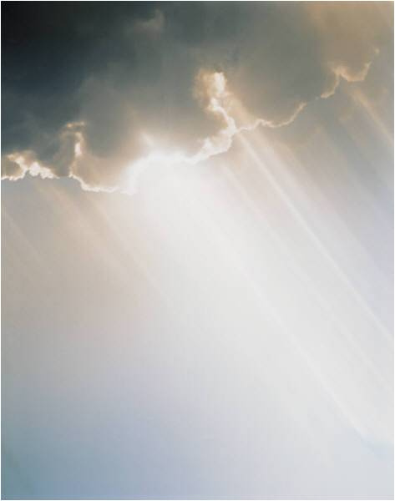
Unto Us a Child is Born
He is the Everlasting God

Slide 35
Unto Us a Child is Born
“Upon the throne of David and over His kingdom,”
A Statement about
His Promise
Notes:
This is a fulfillment of God’s Promise to David (II Samuel 7). [Next Slide] He is the Son of David

Slide 36
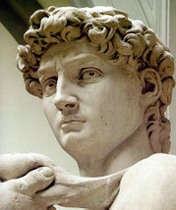
Unto Us a Child is Born
He is the King of David

Slide 37
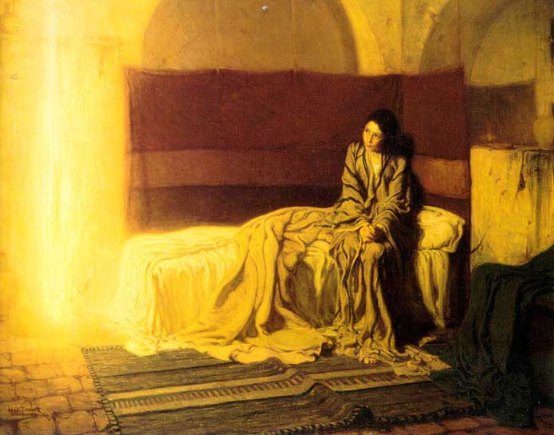
Unto Us a Child is Born
“…the angel said to her, ‘Do not be afraid, Mary, for you have found favor with God. And behold, you will conceive in your womb and bring fort
a Son, and shall call
His name JESUS.”

Slide 38
Unto Us a Child is Born
“He will be great, and will be called the Son of the Highest; and the Lord God will give Him the throne of His father David. And He will reign over the house
of Jacob forever, and
of His kingdom there
will be no end.” (Luke 1:29-33)

Slide 39
Unto Us a Child is Born
“to order it and establish it with judgment and justice from that time forward, even forever.”
A Statement about
His Righteous Character
Notes:
His rule will conform to God's holy and righteous character and demands. [Next Slide] Jesus\Messiah is called "Tsidkineu - The Lord our righteousness" Jeremiah 23:6; I Corinthians 1:30

Slide 40
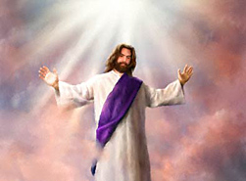
Unto Us a Child is Born
He is the LORD
Our Righteousness

Slide 41
Unto Us a Child is Born
“The zeal of the Lord of hosts will perform this.”
A Statement about
His Determination
Notes:
The coming of the millennial kingdom depends of God, not Israel, not the church, not anyone but God. We cannot even help God usher in the kingdom. The kingdom in its fullness is not now, its still future. It will not come until He comes. Without His sovereign intervention there will be no kingdom! [Next Slide] "Jehovah-Jirah - The Lord will provide". (Exodus - I Corinthians. 10:1-4).

Slide 42
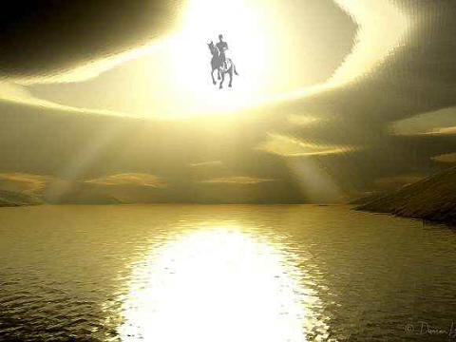
Unto Us a Child is Born
He is the LORD
who Provides

Slide 43
Unto Us a Child is Born
Notes:
King Ahaz did it his way and failed to bring peace and security, but only more hopelessness and darkness.
Just as there was darkness in the days of Isaiah, and in the days in which the Christ was born, there will be darkness in days just prior to His second coming. There is darkness in our day as well. There may be darkness in your own heart. One thing is certain out of darkness Christ’s Kingdom is coming. Are you ready? There are two things we must do in order to prepare ourselves for His coming. We must first enter into His Kingdom by faith alone, in Christ alone, and then, we must remain/abide/continue in His Word and become the faithful, useful and righteous servants of the coming King.
The King is going to rule His Kingdom with justice, righteousness and peace. He is not going to rule alone. There will be those who will have the wonderful privilege to rule with Him or alongside of Him. But only those who are qualified and who have proven their worthiness as servants of the King in this life will do so.
There is hope. Hope shines out of darkness. The gloom and the doom is not final. The darkness and emptiness is not an end in itself but a means whereby God’s goodness can be manifested in the salvation of the land. When every human attempt to bring light has failed, then God will bring light, not because He has to, or that man has force Him, but merely out of His own grace, it is a gift of God.

Slide 44
Unto Us a Child is Born
Receive Him
Praise Him
Serve Him
Delight in Him
Reign with Him

Slide 45
The Vision of Isaiah
Notes:
Trust the Lord and believe His signs/evidence that His Word is true, and you will be established on the earth. Distrust the LORD and refuse the evidence and perish from the earth.

